Slide 1










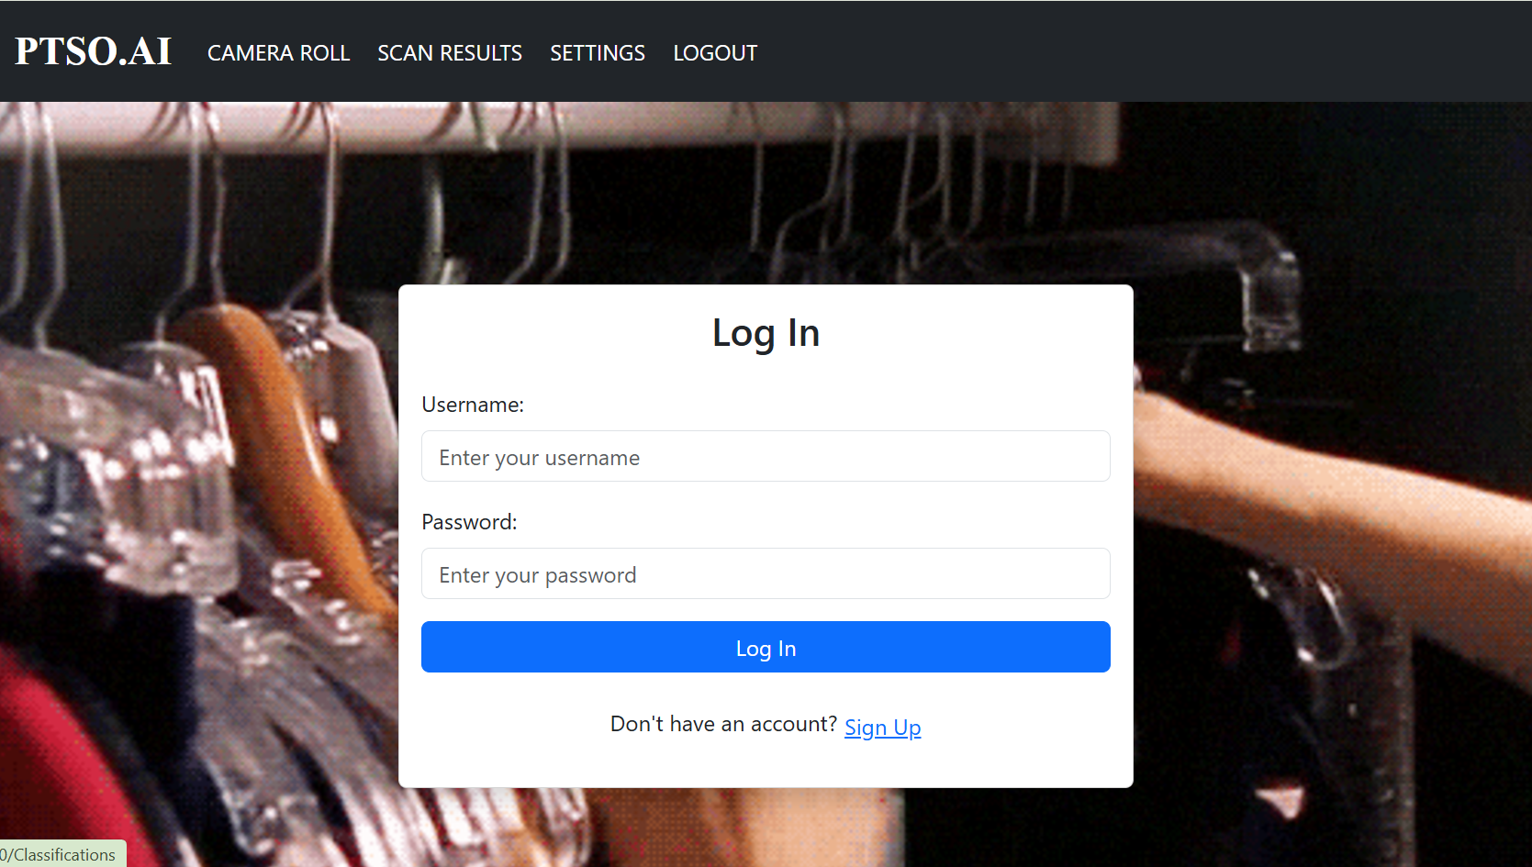
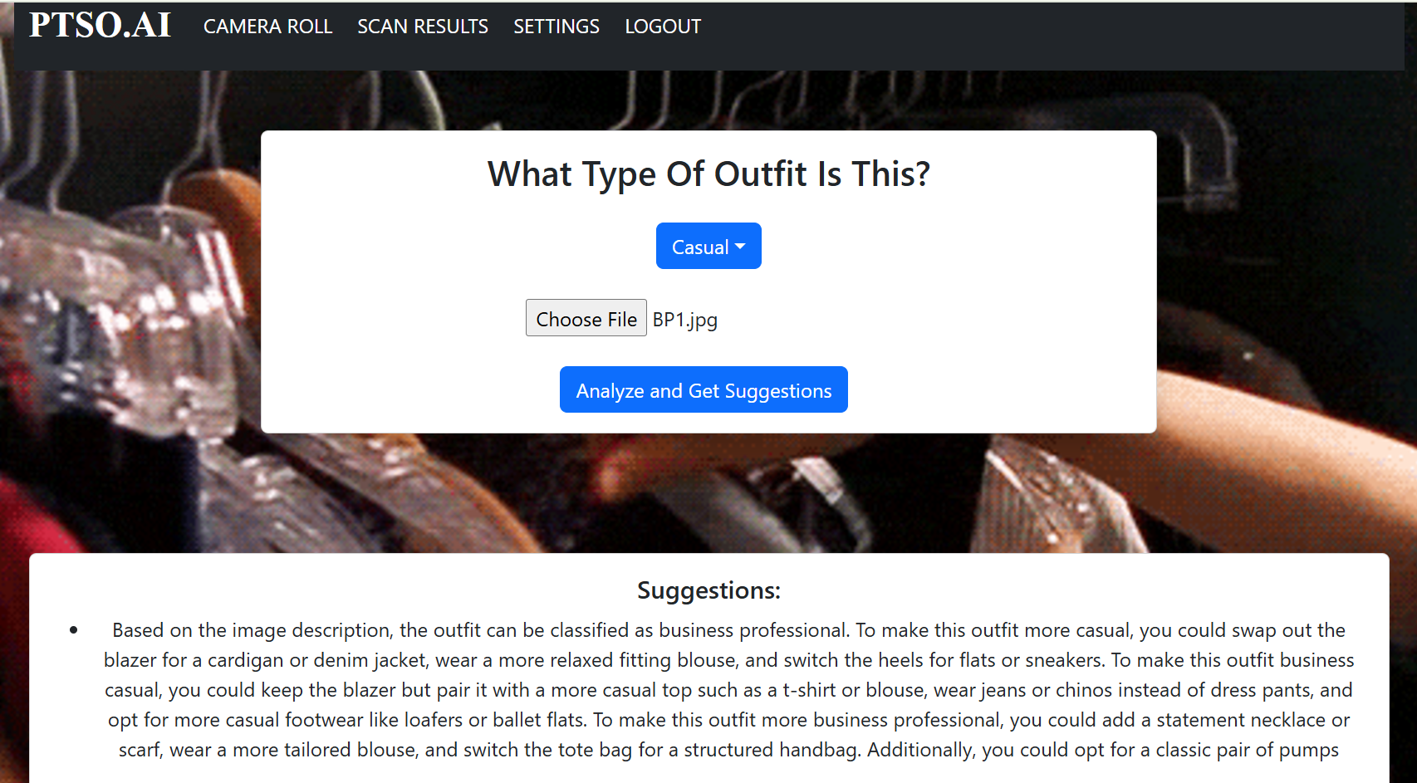
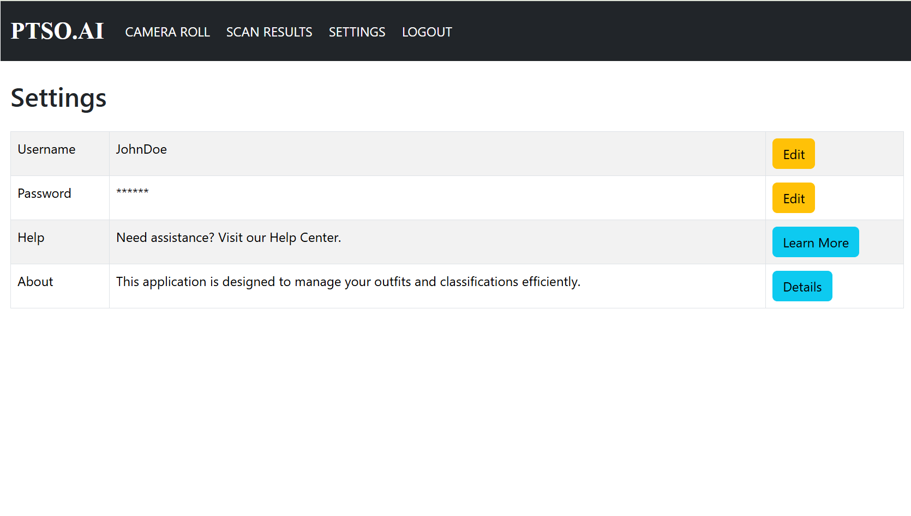
PTSO.AI
Jorge Vasquez, Ke'Arrah Martin, and Ronnie Burns II
COP 3060: Concept Adv Appl Dev
Introduction
Method & Technology Used
Conclusion
PTSO.Ai is your ultimate fashion companion, making outfit planning effortless. Simply choose a style (Business Casual, Business Professional, or Casual), upload a photo of your outfit, and let PTSO.Ai analyze and provide precise fashion advice. Whether refining your look or creating a whole new wardrobe, the app suggests tailored changes and curates outfits to match your taste. With a history feature to revisit past outfits and suggestions, you can learn and repeat with ease. Step out confidently, knowing PTSO.Ai has you covered for every occasion. The future of personal styling starts with PTSO.Ai!
For the development of PTSO.Ai, we used a robust tech stack for efficiency, scalability, and user-friendly design. The backend was built in Java, leveraging its stability and extensive libraries for secure and reliable systems. IntelliJ IDEA served as our IDE, streamlining coding and debugging.
For the frontend, we combined HTML with React to create an intuitive and responsive interface, ensuring a seamless experience for users uploading outfits and receiving advice.
We also used Figma for detailed mock-ups and prototypes, enabling real-time collaboration to refine designs and align with functional requirements. This integration of Java, IntelliJ, HTML, React, and Figma allowed us to deliver a polished, user-focused fashion tech solution
In conclusion, PTSO.Ai stands as a revolutionary application poised to transform the fashion landscape by offering personalized, accurate fashion advice through user-uploaded outfit photos. By addressing challenges such as fashion uncertainty, sustainability, and time efficiency, the app empowers users to make confident, stylish choices effortlessly. PTSO.Ai democratizes access to expert fashion insights while promoting inclusivity and sustainability in the industry. As it evolves, PTSO.Ai promises to be an indispensable tool for modern, fashion-conscious individuals, bridging the gap between technology and personal style with innovation and flair.
Backend/Planning:
Connectivity:
Frontend:
Objective
Process
We wanted to address 3 main issues we noticed in our generation and within the fashion space:
The application solves the problem of not knowing how to dress for various occasions. Even with dress codes, people often wonder, "Is this the right outfit?" Our app analyzes your outfit, provides an accuracy score from extensive references, and offers tailored suggestions to ensure you’re on point.
It tackles the time-consuming uncertainty of choosing an outfit. A task that should take 20 minutes often drags on for an hour. By offering quick, accurate fashion advice, the app helps users decide faster, improving daily efficiency.
The app also addresses expressing personal identity in clothing while staying on theme without professional help. Many lack access to stylists, making it hard to balance personal style with specific criteria. PTSO.Ai provides expert insights, democratizing fashion advice for everyone.
Creating PTSO.Ai was a comprehensive journey that began with multiple planning meetings to outline the project's scope, objectives, and technical requirements. We commenced development with the backend, using Java and IntelliJ IDEA to build a robust foundation for data handling and processing. Concurrently, we designed the user interface using Figma to visualize the app's aesthetics and user experience. Once the backend was solidified, we transitioned to the frontend, leveraging HTML and React to bring the visual designs to life. At every major milestone, rigorous testing was conducted to ensure functionality and performance, involving both unit tests and user acceptance testing. This iterative process, punctuated by regular team reviews and feedback sessions, ensured that the final product was polished, user-friendly, and met our high standards for quality and reliability.
Results
Log in:
Home:
User Settings:​
Acknowledgements
Here is a peak at the log in screen to log into your personal fashion assistant in PTSO.Ai this is essential to make sure your data and suggestions are personalized for you.
Here is an example of what it will look like once you input your image and get your suggestions. Notice the gif in the back actually changes with each type of outfit
We would like to acknowledge:
FAMU CIS Department for their support and resources throughout this project.
Special thanks to Professor Ms. Vanessa Coote for her guidance and invaluable feedback during the development of PTSO.Ai.
This is one of our pages, it is the settings page where you can change your profile and get help if need be!

